Slide 1


Slide 2
Minglong Wang, Hang Yu
Chinese Academy of Sciences, China
email: minglong.wang@ipp.ac.cn
12/12/2023

Slide 3
I Hypotheses Development
The problem of disruption prediction is regarded as a classification problem of multivariate time series.
We divide each shot into multiple time series Windows and make predictions about each window to predict whether it will disrupt.
We assume that all the signals corresponding to the C-mod machine are useful for disruption prediction, so we do not do artificial feature selection.
2

Slide 4
II Methodology: Strategy
Data Processing
Unified the signal names
Correct time for all signals
Downsampling the signal at the sampling frequency of 5000
Handle nan value
Lable each shot
Divide a sliding window for each shot
40ms or 100ms early warning area
93
Random sliding steps
Sliding step = 1
3

Slide 5
II Methodology: Strategy
Hyperparameter tuning and model selection
LSTM+CNN
Transformer
….......
A simple two-layer LSTM + gMLP
Randomforest
gMLP
3

Slide 6
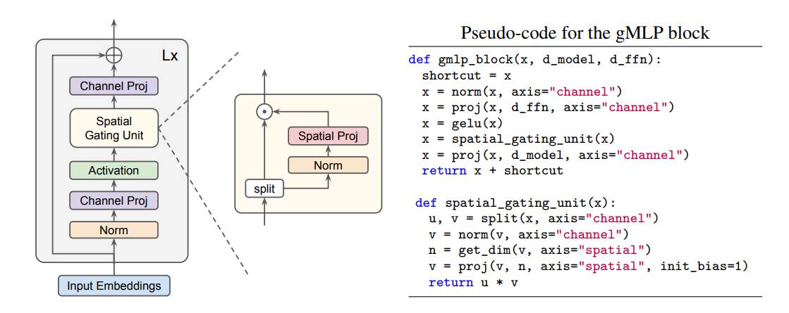
III Methodology: Model Architecture
Figure 1: Overview of the gMLP architecture with Spatial Gating Unit (SGU)
Training time: 2.4h on 3090
4
Liu H, Dai Z, So D, et al. Pay attention to mlps[J]. Advances in Neural Information Processing Systems, 2021, 34: 9204-9215.

Slide 7
IV Results
F1 score on LSTM:0.75
F1 score on gMLP:0.769
Ensembled F1 score:0.78
5

